Slide 1
Lesson Seven
Cleaning and pest control

Slide 2

Discuss
Can cleaning products cause food poisoning?
Notes:
Can cleaning products cause food poisoning?
Yes! Cleaning products, and other chemical agents that are usually stored ‘under the sink’ are, by definition, toxic to life. This generally includes all life, not just bacteria. Therefore they are also poisonous to humans and other animals such as household pets. They should be fully labelled and stored carefully and securely.

Slide 3
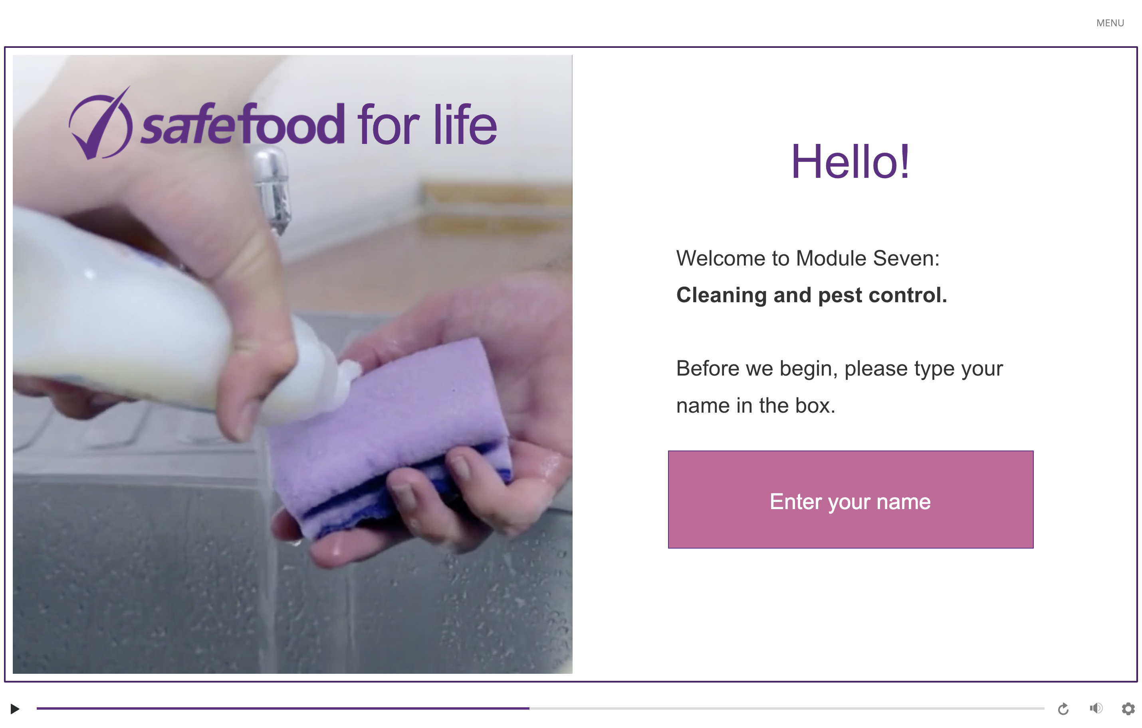
eLearning module

Slide 4
In class task
Examine a mousetrap:
  How does it work?
  What types of bait would be suitable?
How can you reduce the risk of pests?
Notes:
What types of bait would be suitable?
Peanut butter, bird seeds and chocolate
How can you reduce the risk of pests?
Keep the business clean
Cover food at all times
Store food off the ground and in pest proof containers
Check incoming goods
Check regularly for signs of infestation
Rotate stock
Keep well fitted lids on bins
Keep doors and window screens closed

Slide 5
Homework task
Find articles online about pest infestations in restaurants.
  What happened?
  What was the outcome?
  How could it have been prevented?

